Slide 1

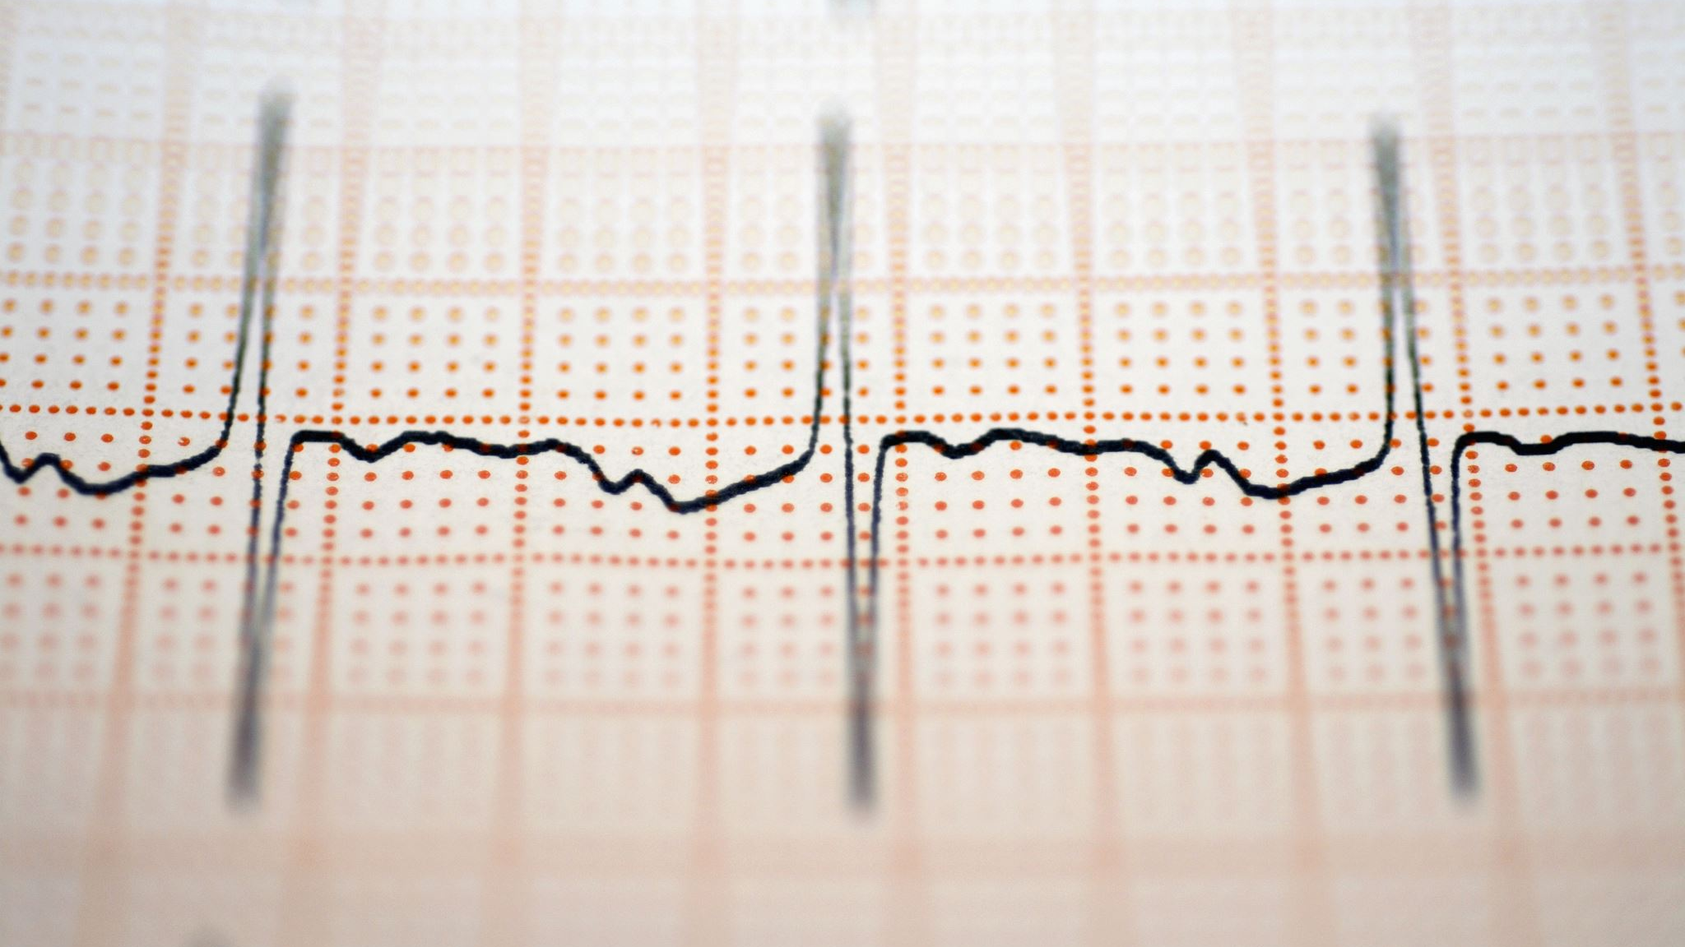
Digital Signal Processing Techniques for Removing Noise from ECG Signals
~HARISH M(21BEC1142)
~RAKESH RAM M(21BEC1836)

Slide 2
INTRODUCTION: ~Electrocardiogram (ECG) is a signal that describes the electrical activity of the heart. ~The ECG signal contains- a P wave (due to atrial depolarization), a QRS complex (due to atrial repolarization and ventricular depolarization) and a T wave (due to ventricular repolarization).

Slide 3
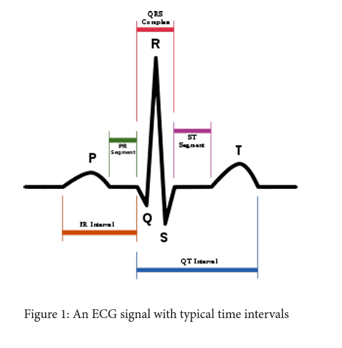

Slide 4



The electrocardiogram (ECG) signals contain many types of noises 1.Baseline wander, 2.Powerline interference, 3.Electromyographic (EMG) noise, 4.Electrode motion artifact noise.

Slide 5

BASELINE WANDER:

Slide 6
Baseline wander or baseline drift is the effect where the base axis (x-axis) of a signal appears to ‘wander’ or move up and down rather than be straight. This causes the entire signal to shift from its normal base. In ECG signal, the baseline wander is caused due to improper electrodes (electrode-skin impedance), patient’s movement and breathing (respiration). Figure 2 shows a typical ECG signal affected by baseline wander.

Slide 7
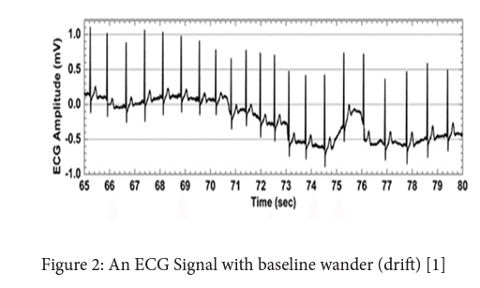

Slide 8
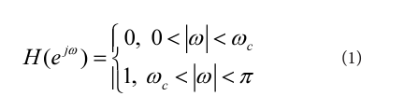
Techniques for Removal of Baseline Wander
A straightforward approach to the design of a filter is to choose the ideal high-pass filter as a starting point

Slide 9
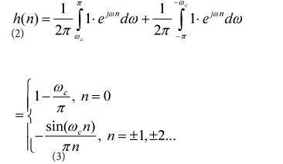
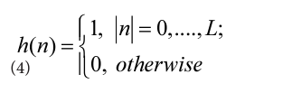
Since the corresponding impulse response has an infinite length, truncation can be done by multiplying h(n) by a rectangular window function, defined by

Slide 10
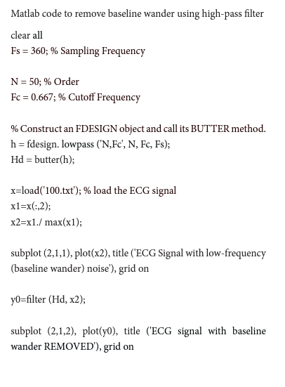

Slide 11
Wavelet transform can also be used to remove the baseline wander from ECG signal. The frequency of baseline wander is approximately 0.5 Hz. According to discrete wavelet transform (DWT), the original signal is to be decomposed using the subsequent low-pass filters (LPF) and high-pass filters (HPF). The cut-off frequency for LPF and HPF will be half of the sampling frequency

Slide 12
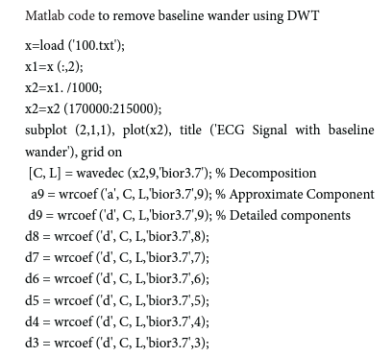
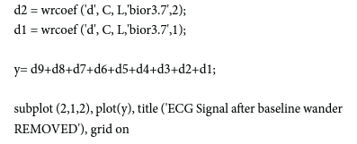

Slide 13
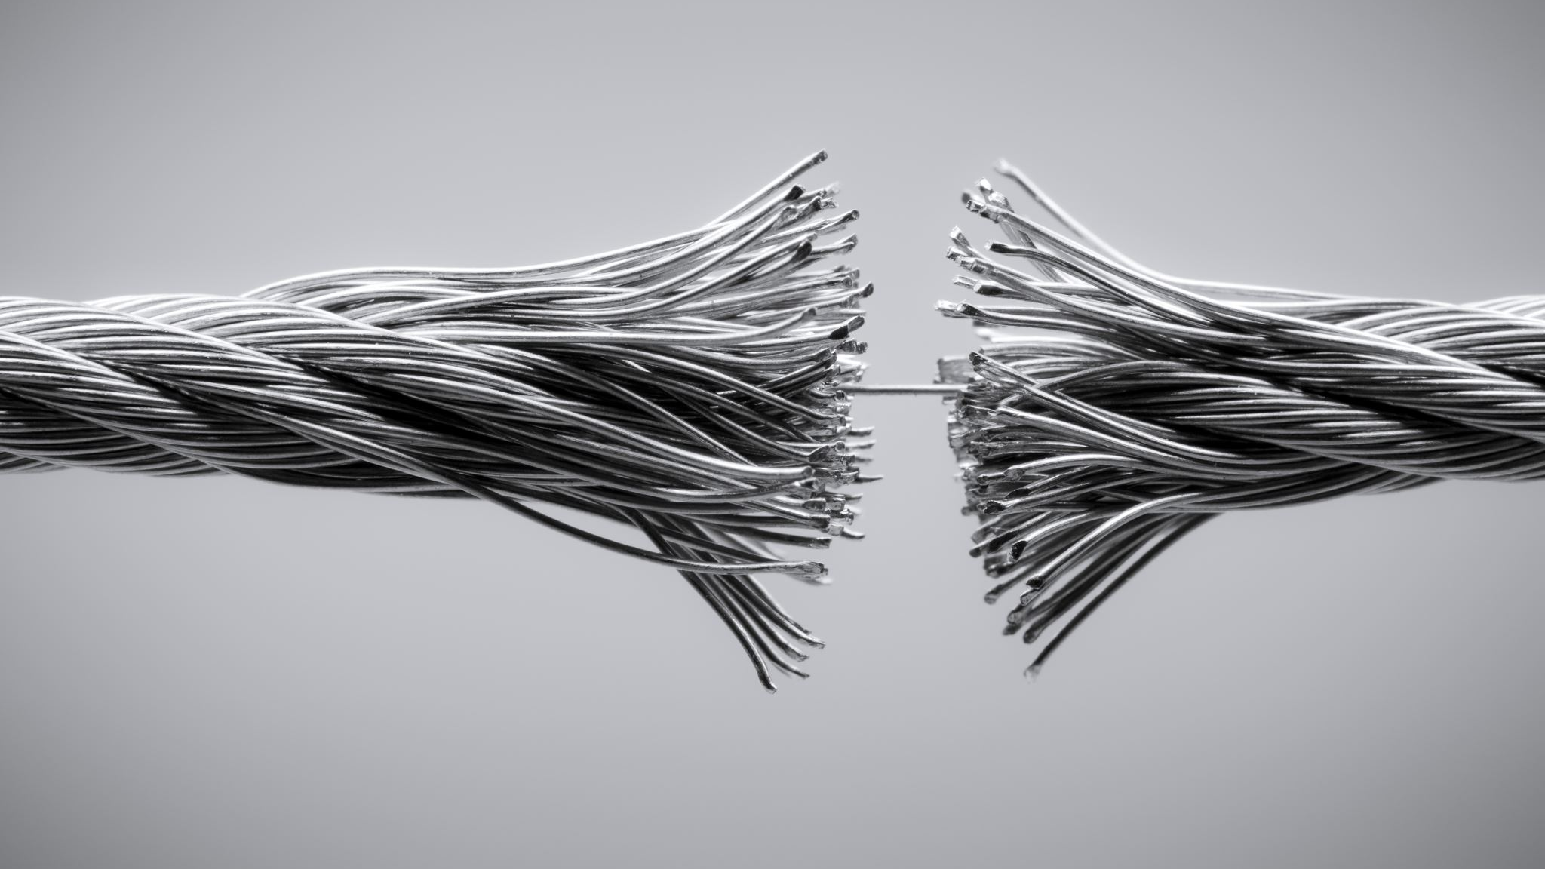
Powerline Interference

Slide 14
Electromagnetic fields caused by a powerline represent a common noise source in the ECG, as well as to any other bioelectrical signal recorded from the body surface. Such noise is characterized by 50 or 60 Hz sinusoidal interference, possibly accompanied by a number of harmonics.

Slide 15
Such narrowband noise renders the analysis and interpretation of the ECG more difficult, since the delineation of low-amplitude waveforms becomes unreliable and spurious waveforms may be introduced. It is necessary to remove powerline interference from ECG signals as it completely superimposes the low frequency ECG waves like P wave and T wave

Slide 16
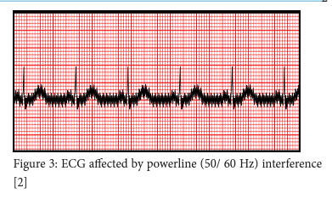

Slide 17
Techniques for Removal of Powerline Interference

Slide 18
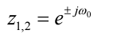
A very simple approach to the reduction of powerline interference is to consider a filter defined by a complexconjugated pair of zeros that lie on the unit circle at the interfering frequency

Slide 19
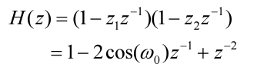
Such a second-order FIR filter has the transfer function

Slide 20
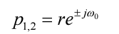
Since this filter has a notch with a relatively large bandwidth, it will attenuate not only the powerline frequency but also the ECG waveforms with frequencies close to0 ω. It is, therefore, necessary to modify the filter in (6) so that the notch becomes more selective, for example, by introducing a pair of complexconjugated poles positioned at the same angle as the zeros but at a radius r,

Slide 21
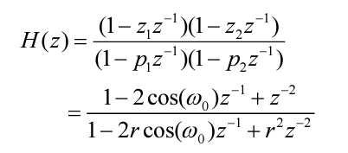
The transfer function of the resulting IIR filter is given by

Slide 22
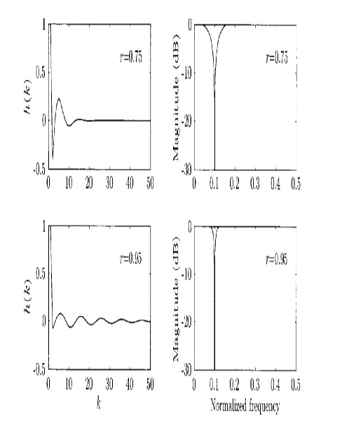
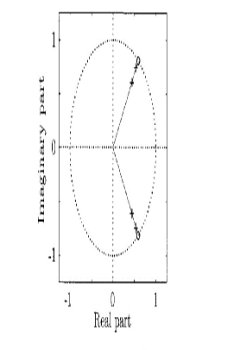

Slide 23
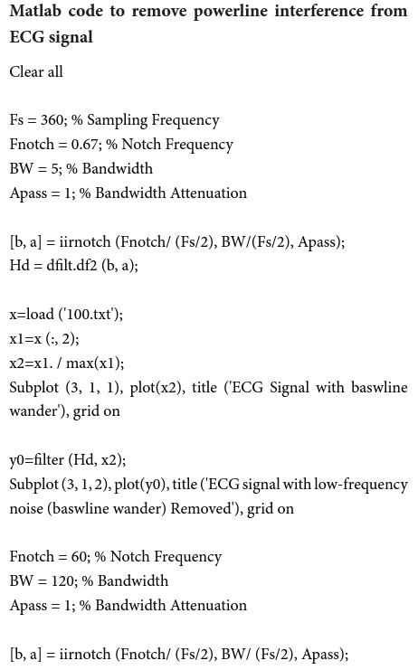
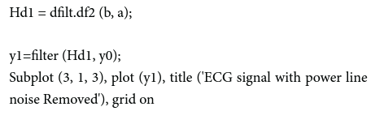

Slide 24

Electromyographic(EMG) artifacts

Slide 25
The presence of muscle noise represents a major problem in many ECG applications, especially in recordings acquired during exercise, since low amplitude waveforms may become completely obscured

Slide 26
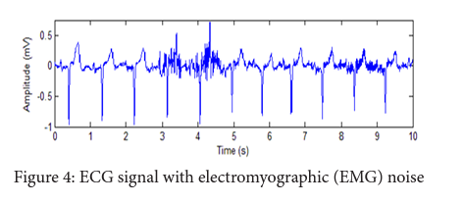

Slide 27
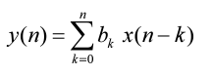
The EMG noise is a high-frequency noise; hence an n-point moving average (MA) filter may be used to remove, or at least suppress, the EMG noise from ECG signals. The general form of an MA filter is

Slide 28
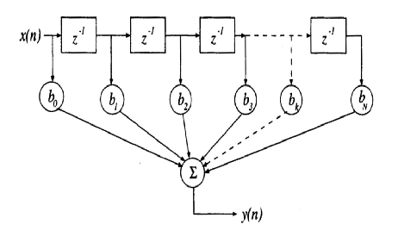
The signal-flow diagram of a generic MA filter

Slide 29
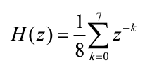
. If the signal samples over a window of eight samples are averaged, we get the output as

Slide 30
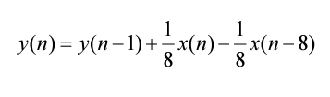
The 8-point MA filter may be rewritten as

Slide 31
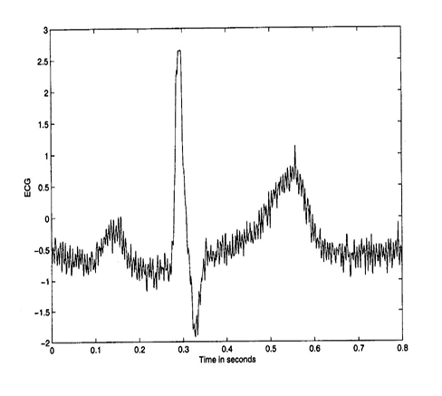
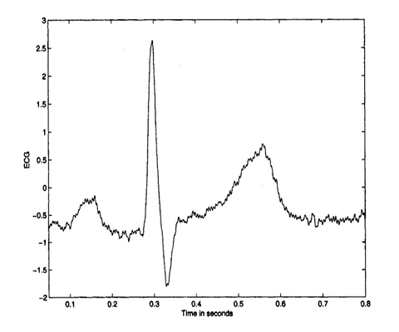

Slide 32
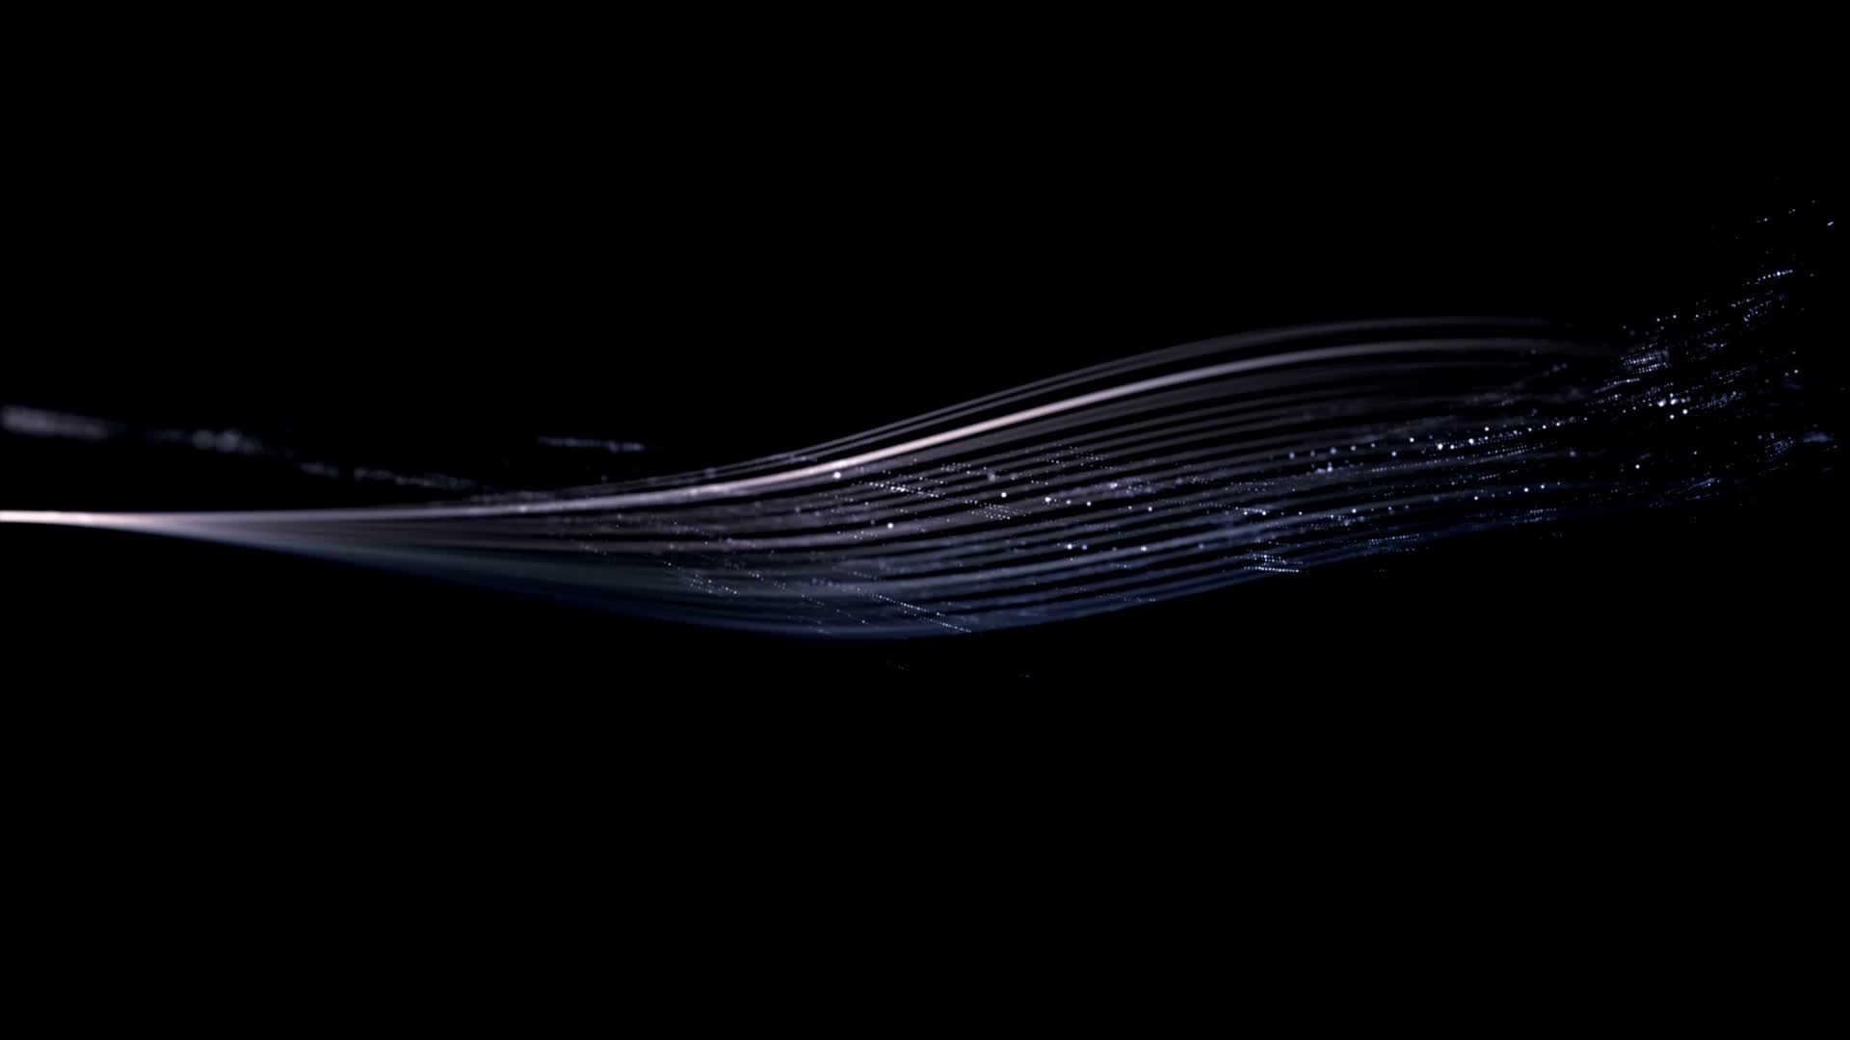
Electrode Motion Artifacts

Slide 33
Electrode motion artifacts are mainly caused by skin stretching which alters the impedance of the skin around the electrode. Electrode motion artifacts are particularly troublesome in the context of ambulatory ECG monitoring where they constitute the main source of falsely detected heartbeats

Slide 34
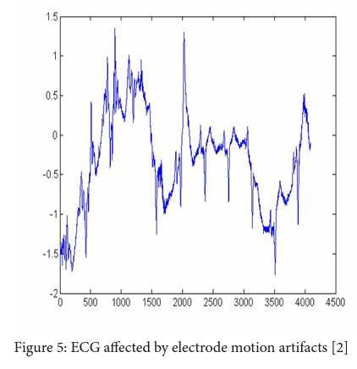

Slide 35

Techniques for Removal of Electrode Motion Artifacts

Slide 36
~One of the widely used techniques for removing the electrode motion artifacts is based on adaptive filters. ~The general structure of an adaptive filter for noise canceling utilized in this paper requires two inputs, called the primary and the reference signal. ~The former is the d(t) = s(t) + n1 (t) where s(t) is an ECG signal and n1(t) is an additive noise.

Slide 37

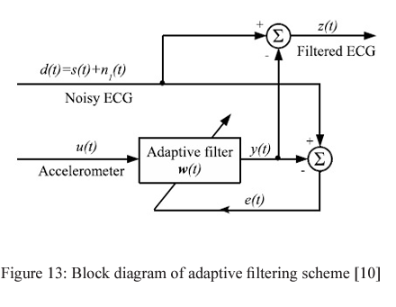
The second input is a noise u(t) correlated in some way with n1 (t) but coming from another source. The adaptive filter coefficients wk are updated as new samples of the input signals are acquired. The learning rule for coefficients modification is based on minimization, in the mean square sense, of the error signal e(t) = d(t) − y(t) where y(t) is the output of the adaptive filter

Slide 38
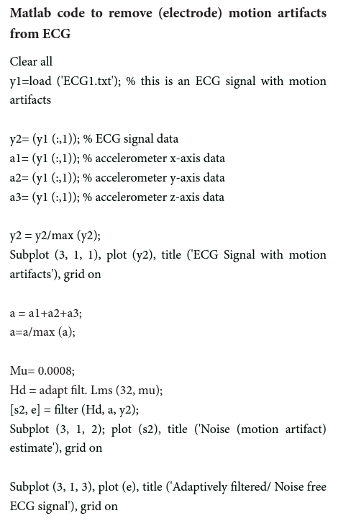

Slide 39
THANK YOU

